Slide 1
Pathway to Jobs: Empowerment Journey
Here is where your presentation begins

Slide 2
Table of contents
01
04
02
05
03
06
Problem Statement and its impact
Technology Used
Possible Solution
Codes
Key Features
Conclusion

Slide 3
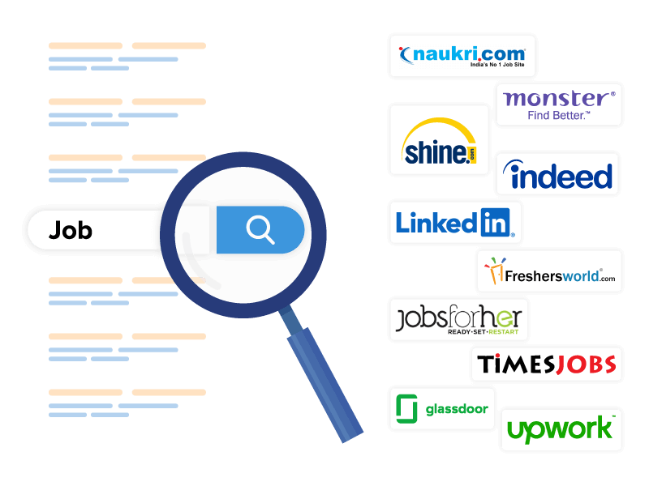
01
Problem Statement and Its Impact
A fragmented ecosystem of online job boards, company websites, and personal networks characterizes the current job search process. This creates significant challenges for both employers and job seekers.

Slide 4
Challenges Faced
Employers | Job Seekers
Struggle to efficiently reach qualified candidates due to dispersed job listings and a lack of targeted recruitment tools. Manual screening of applications consumes valuable time, and filling open positions can be a slow and cumbersome process. | Face difficulties in discovering relevant opportunities that align with their skills and career aspirations. Searching through numerous platforms is time-consuming, and limited personalization in job recommendations leads to a high volume of irrelevant postings. This results in frustration and a sense of discouragement.

Slide 5
Impact
Reduced Productivity: Inefficient job search processes lead to lost time and resources for both employers and job seekers. Employers struggle to fill positions quickly, impacting their bottom line. Job seekers may experience extended periods of unemployment or underemployment, hindering career progression.
Missed Connections: The lack of a centralized, user-centric platform prevents ideal candidate-employer matches. Employers miss out on top talent, and qualified job seekers fail to find their ideal positions.
Frustration and Discouragement: The laborious and unrefined nature of the current job search experience leads to frustration and discouragement for both parties. Employers face a negative impact on their employer brand, while job seekers lose motivation in their career search.

Slide 6
02
Possible Solution

Slide 7
Comprehensive job listings: A centralized platform that aggregates and organizes job postings, making them easily searchable and accessible.
Advanced search and filtering: Functionality allows users to efficiently find relevant jobs based on location, keywords, and other criteria.
Efficient retrieval: Through the efficient storage of user profiles and job postings, the platform helps in straightforward retrieval and classification, hence promoting the effective matching of job prospects with appropriate opportunities.
Streamlined application process: A smooth and user-friendly system for submitting job applications, including registration and application tracking system.

Slide 8

03
Key Features
The Job Board with Search and Recommendations project aims to provide a comprehensive and user-friendly platform for both employers and job seekers. Here's a breakdown of the key features that will address the inefficiencies of the current job search landscape:

Slide 9
Key Features
For Job Seekers | For Employers
Job Search Advanced Search & Filters Search History & Saved Jobs Job Alerts | Job Posting & Management
Personalized Recommendations | Targeted Job Distribution
User Profiles | Applicant Search & Filtering
Streamlined Application Process | Communication Tools

Slide 10
Additional Features
Company Profiles: Employers can create company profiles showcasing their work culture, benefits, and career opportunities to attract top talent.
Reviews & Ratings: Enable job seekers to leave reviews and ratings for companies, fostering transparency and informing informed career decisions. (Consider compliance regulations)
Analytics & Reporting: Provide employers with insights into job performance, candidate demographics, and application trends to optimize their recruitment strategies.

Slide 11
User Experience Focus
Company Profiles: Employers can create company profiles showcasing their work culture, benefits, and career opportunities to attract top talent.
Reviews & Ratings: Enable job seekers to leave reviews and ratings for companies, fostering transparency and informing informed career decisions. (Consider compliance regulations)
Analytics & Reporting: Provide employers with insights into job performance, candidate demographics, and application trends to optimize their recruitment strategies.

Slide 12

04
Technology Stack

Slide 13
Front-End:
HTML: Provides structure and content for web pages.
CSS: Controls visual elements like colors, fonts, and layouts for a pleasing user interface.
JavaScript: Adds interactivity and dynamic functionality to the user interface for features like search filters, user interaction, and potentially autocomplete suggestions.
Back-End:
Node.js: A JavaScript runtime environment that allows for server-side scripting, well-suited for building real-time applications and APIs due to its asynchronous and non-blocking nature.
Express.js: A web framework built on top of Node.js that simplifies development by providing features like routing, middleware, and templating. It will be used to structure the server-side application and handle user requests.
MySQL: A popular open-source relational database management system (RDBMS) to store and manage data for the job board. This includes job listings, user profiles, application data, and potentially recommendation algorithms' training data.

Slide 14

04
Codes

Slide 15
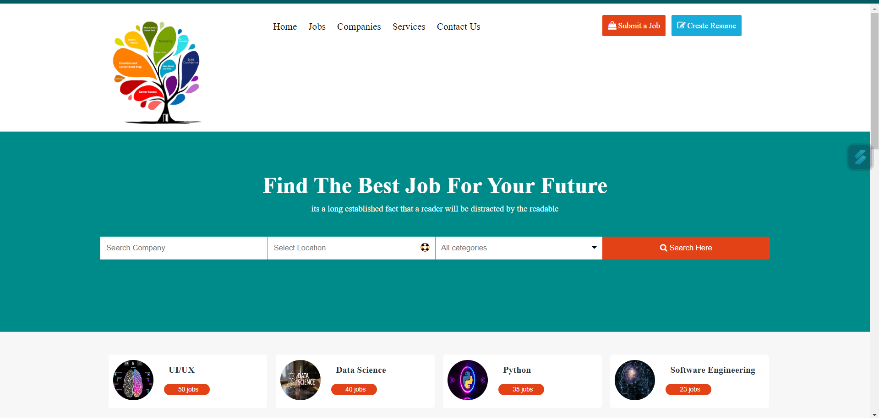
Page 1: index.html(main page)

Slide 16
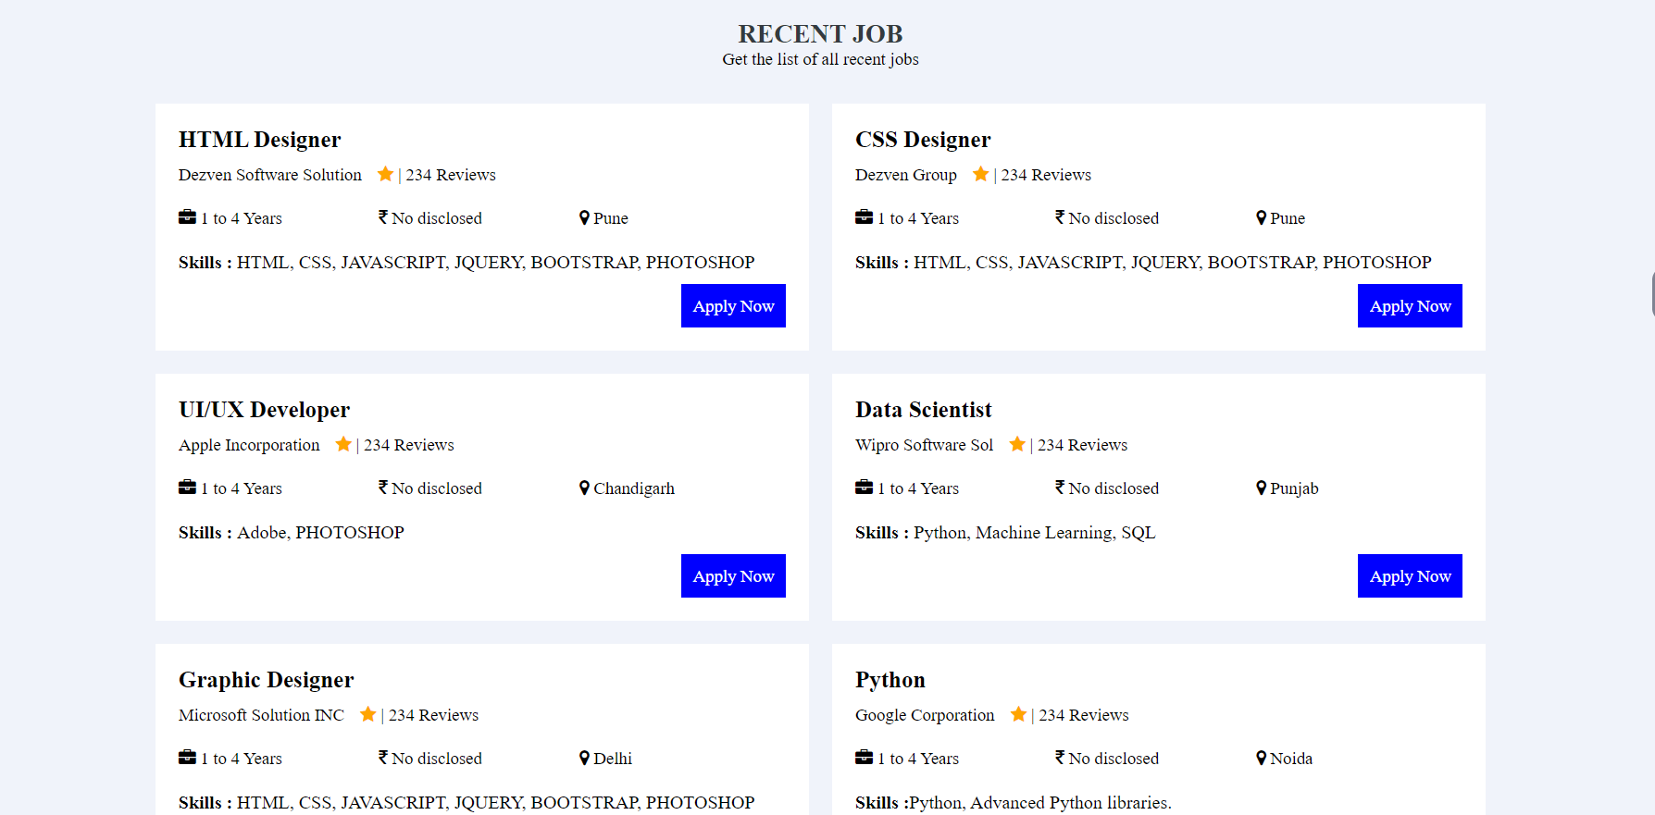
Page 1: index.html(main page)

Slide 17
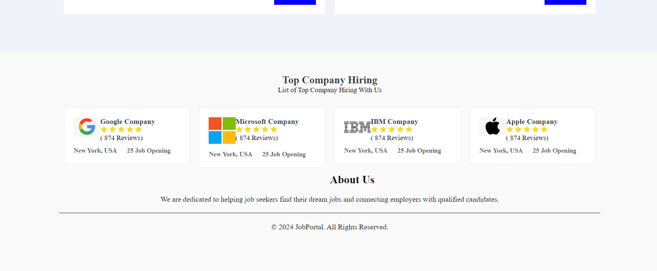
Page 1: index.html(main page)

Slide 18
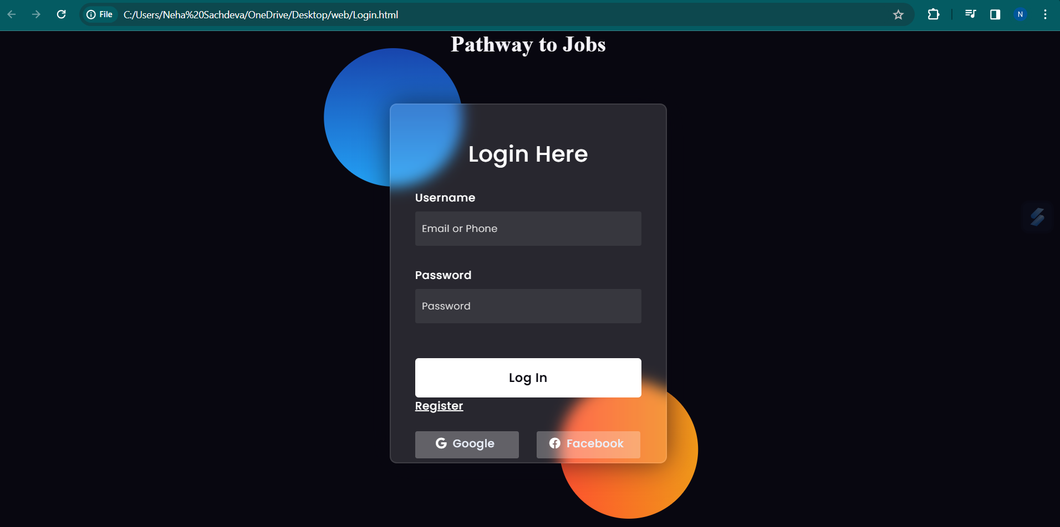
Page 2: login.html(main page)

Slide 19

Page 3: register.html(main page)

Slide 20

Node.js

Slide 21
Node.js

Slide 22
THANK YOU

